Slide 1
Rotten Tomatoes Sentiment Analysis
Ruochong Fan
Yuzhao Jin

Slide 2
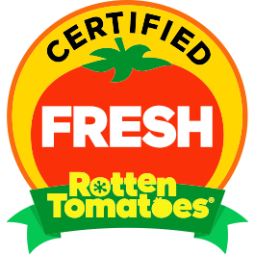
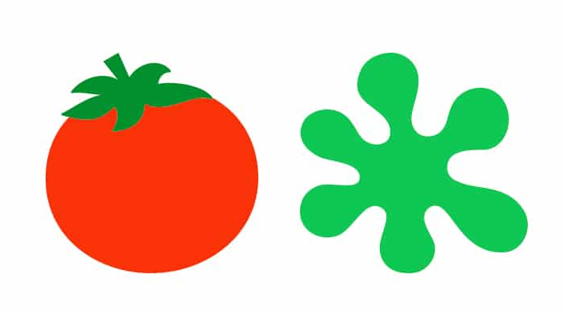
Intro
Rotten Tomatoes: one of the most influential social platforms for evaluating the qualities and productions of films[1]
Founded in 1998 by three students in UC Berkeley
Tomatometer: Fresh and Rotten

Slide 3
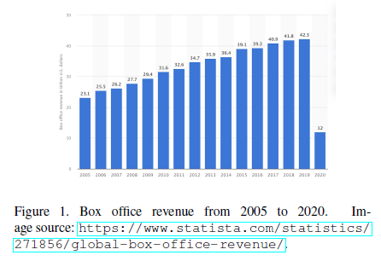
Motive
Crash in box office revenue after Covid-19 [2][3]
Choosing Rotten Tomatoes
Analyze sentiment and natural language

Slide 4
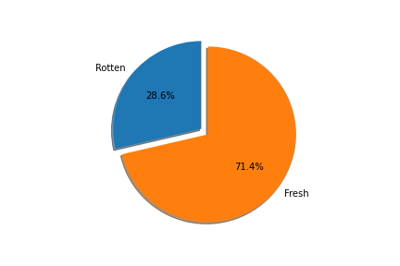
Data
Source of Data:
Pre- processed file from Stefano Lenone in Kaggle [4]
January 2020 to October 2020 (latest update)
Column Selections
Review Contents: Comments
Review Types (Fresh(1)/Rotten(-1))
Initial Finding: 71.4% Fresh vs. 28.6% Rotten
Cleaning Procedures
Remove punctuation & numbers
All words to lower cases
NLTK[5]: Stopwords Removal , Lemmatization[6], Tokenization
Vectorization: 45746 * 32922 matrix of numbers

Slide 5
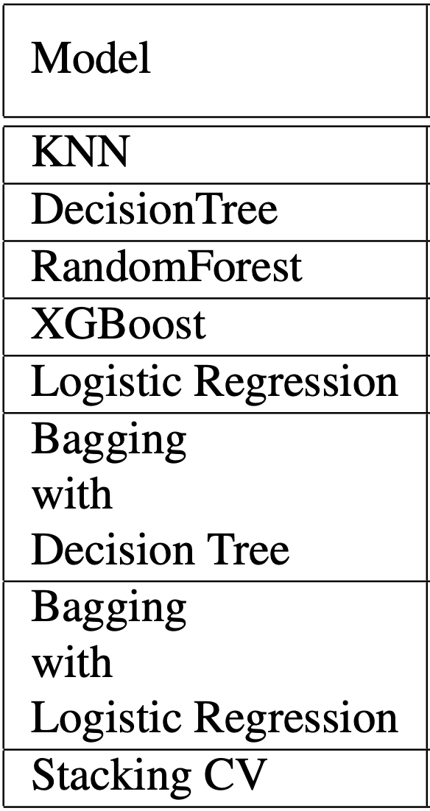
Proposed Models
80% training, 20% testing
7 Models selected
Parameters choices
GridSearch
Hyperparameter optimization

Slide 6
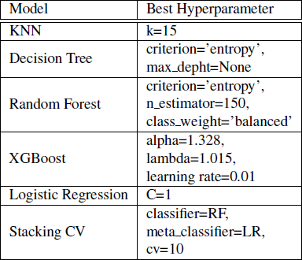
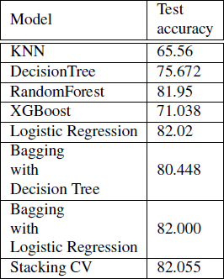
Results
Random Forest (RF) and Logistic Regression(LR) outstand other models in normal test accuracy
Including their Stacking CV and Bagging (LR)
From highest to lowest: Stacking CV(82.055%), LR(82.02%), Bagging (LR)(82%), RF(81.95%)

Slide 7
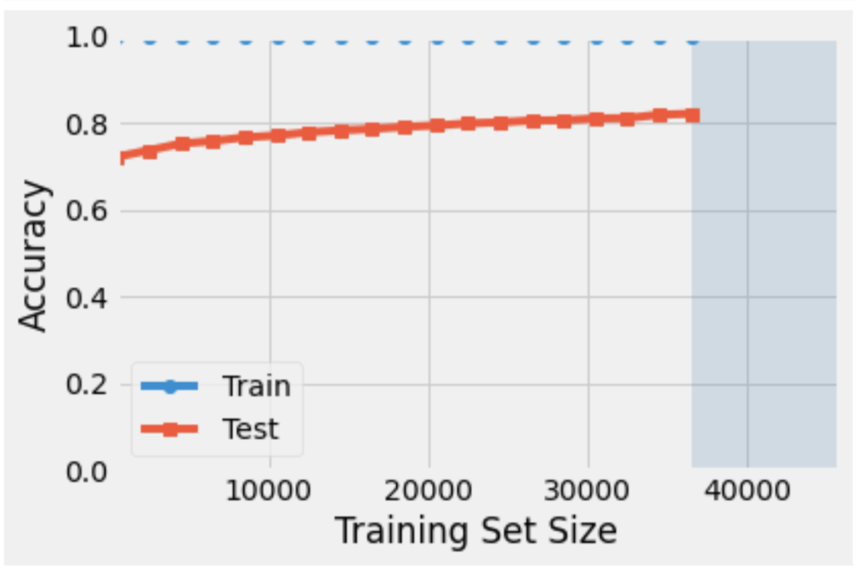
Gradual Trends on Train vs. Test
Random Forest Example
Common trends on all models

Slide 8
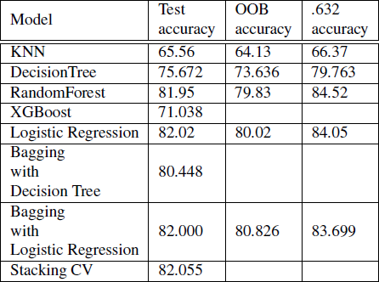
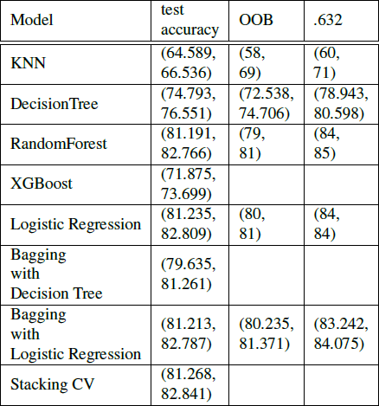
Bootstrap Updates
Out-of-Bag (OOB) and .632 Bootstraps are performed in tuning testing accuracies
Bagging (Decision Tree) and XGBoost fails due to run-time issues, Stacking CV parameters have been pre-determined based on each of their parameters.
LR and RF still performs well in Bootstraps (especially in .632 which both exceed 84%)

Slide 9
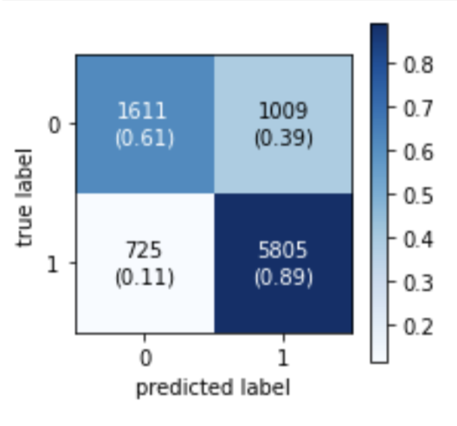
Prediction Accuracies
Confusion Matrix
True Prediction Percentage = (TP + TN)/n_test
True Prediction Percentage Results
ACC=81.05%

Slide 10
Evaluation
Hardware Issues (Run-time issue is significant, especially for Bagging and RF)
Bias issues in bootstraps
OOB suffers from pessimistic bias, .632 suffers from optimistic bias
.632+ was not available due to MemoryError from Hardwares (Possibly due to large quantity of dataset)
Dataset missing dates
Possible inaccuracies of “Fresh” and “Rotten” rate when extracting 2020 data.
Stacking CV
Overfitting issues
Runtime issues (Not able to use Bootstraps)

Slide 11
Conclusion
RandomForest:
. 632 Bootstrap accuracy 84.54%
True prediction percentage: 81.05%
Logistic Regression:
Testing Accuracies 82.02%

Slide 12
Acknowledgement
This project team appreciates and thanks Rotten Tomatoes and user Stephano Leone from Kaggle for providing information on review comments and the organized dataset.
We also thank Prof. Sebastian Raschka in providing suggestions and guidance throughout this project.

Slide 13
Sources
[1] Rotten Tomatoes. About Rotten Tomatoes. Fandango, 2020. https://www.rottentomatoes.com/about
[2] M. Pamela. 2019 Global Box Office Revenue Hit Record $42.5B Despite 4 Percent Dip in U.S.Billboard, 2020. https://www.billboard.com/articles/news/8547827/2019-global-box-office-revenue-hit-record-425b-despite-4-percent-dip-in-us/.
[3] J. Navbarro. Global box office revenue from 2005 to 2020. Statista, 2021. https://www.statista.com/statistics/271856/global-boxoffice-revenue/
[4] S. Leone, Rotten Tomatoes movies and critic reviews dataset. Kaggle, 2020. https://www.kaggle.com/stefanoleone992/rottentomatoes-movies-and-critic-reviewsdataset?select=rotten tomatoes critic reviews.csv/.
[5] S. Bird, E. Klein, and E. Loper. Natural Language Processing with Python. O’Reilly Media Inc, 2009. https://www.nltk.org/book
[6] C. Manning, P. Raghavan, and H. Sch¨utze. Introduction to Information Retrieval. Cambridge University Press, 2008. http://nlp.stanford.edu/IR-book/informationretrieval-book.html

Slide 14
Thanks for Listening!

